Slide 1
IMDB Movies
Presenters:
Ashley J. Showers
Brittany Clemmons
Michael Schleiffarth
Xinliang Huang

Slide 2
Dataset Description
Data Source: Kaggle
Dataset Name: IMDB 5000 Movie
Data Cleaning: Remove missing value rows, 3756 rows for analysis.
Programming language: Python
Modules/Packages:
Pandas, matplotlib.pyplot, numpy, seaborn scipy.stats

Slide 3
Research Questions
What is the standard for a successful movie?
Profit, IMDB score, Facebook likes?
What does each of them depends on?
Budget, content rating, duration, aspect ratio, actor, director?

Slide 4
Research Questions
Main Question: What makes a successful movie?
Sub-Questions
What controllable variables will affect profit?
How does budget affect movie success?
Is there any difference of IMDB scores among all content ratings?
Is there any difference of IMDB scores between long and short movies?
Is there any difference of IMDB scores among all content ratings stratified by movie length?
Does an increase in the quantity of movies made, increase a director’s mean IMDB scores?
Does hiring the most popular actors guarantee high IMDB scores?

Slide 5
Hypothesis
H₀: There is no effect for duration and content rating on profit.
H₁: There is an effect for duration and content rating on profit.
H₀: The mean IMDB scores are identical for each content rating.
H₁: The mean IMDB scores are not identical for content ratings.
H₀: The mean IMDB scores between short and long movie are the same.
H₁: The mean IMDB scores between short and long movie are different.
H₀: Among longer movies, the mean IMDB scores are identical for each content rating.
H₁: Among shorter movies, the mean IMDB scores are different for content ratings.
Notes:
Duration and content rating both appear to have an effect on profit. Longer movies with g or pg ratings are the most successful
Higher budgets result in slightly higher imdb scores and much higher facebook likes
The mean IMDB scores are not identical for each content rating.
The mean IMDB score of longer movies(6.82) is significantly higher than shorter movies(6.12).
The mean IMDB scores are not identical for each content rating among longer movies, and it showed the similar pattern among shorter movies.

Slide 6
Hypothesis cont.
5. H₀: The budget has no effect on movie success
H₁: the budget will effect the success of a movie
6. H₀: The mean IMDB score will increase with the quantity of movies made per director.
H₁: The mean IMDB score will not increase with the quantity of movies made per director.
7. H₀: The mean IMDB score will increase with the quantity of appearances by top actors.
H₁: The mean IMDB score will not increase with the quantity of appearances by top actors.
8. H₀: The aspect ratio of a movie will not effect the profit of a movie
H₁: The aspect ratio of a movie will effect the profit of a movie
Notes:
Duration and content rating both appear to have an effect on profit. Longer movies with g or pg ratings are the most successful
Higher budgets result in slightly higher imdb scores and much higher facebook likes
The mean IMDB scores are not identical for each content rating.
The mean IMDB score of longer movies(6.82) is significantly higher than shorter movies(6.12).
The mean IMDB scores are not identical for each content rating among longer movies, and it showed the similar pattern among shorter movies.

Slide 7
Exploratory Data Analysis

Slide 8
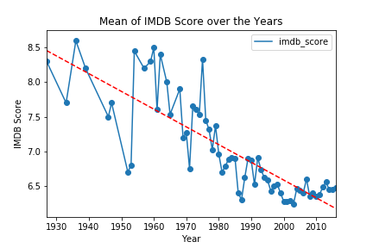
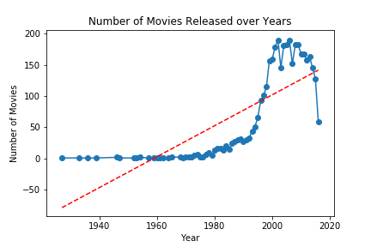
Number of Movies & Mean IMDB Scores over Years
It indicates that mean IMDB score for all years is over 6.0 and decreased over the years. And there is a sharp decline in the mid 50s. Combine this graph and the imdb score trend graph, it demonstrates that producers pay much attention to the quantity of movies instead of quality.

Slide 9
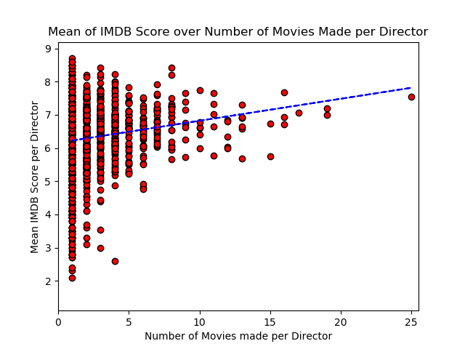
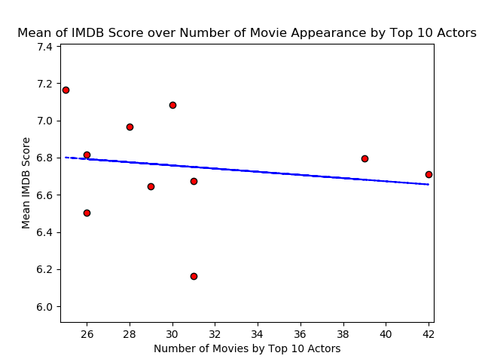
Mean IMDB Score Compared over: Number of Movies Made by Director & Appearances of Top Actors

Slide 10
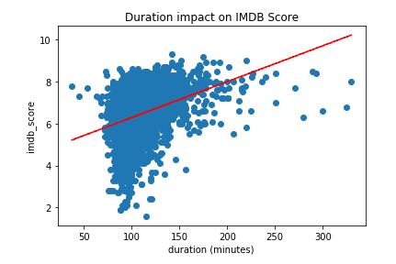
Length of movies vs IMDB scores

Slide 11
Statistical Data Analysis

Slide 12
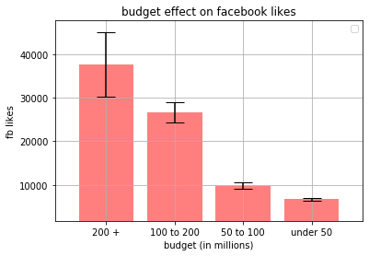
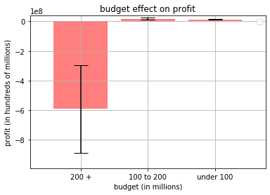
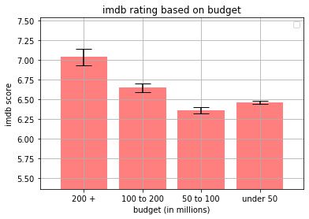
Budget Effect on Movie Success

Slide 13
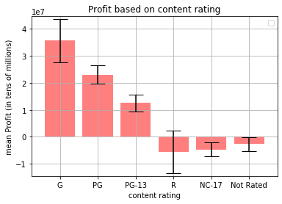
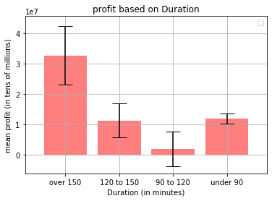
What controllable variables will affect profit?

Slide 14
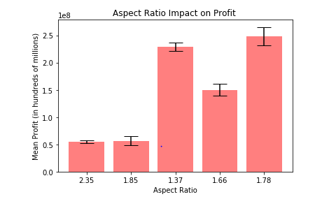
Aspect Ratio impact on Profit

Slide 15
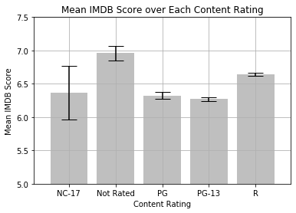
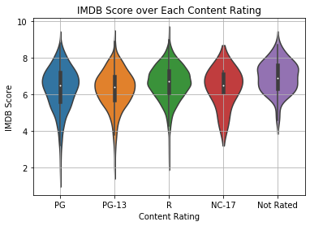
Mean IMDB Scores for Each Content Rating
ANOVA: F-Statistic=29.37, P-value=4.42e-24
P-value is less than 0.05, so the mean IMDB scores are significantly different among 5 content ratings.

Slide 16
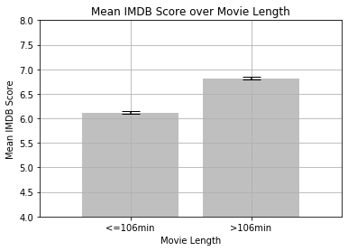
Long movie vs Short Movie
T-test for IMDB score:
Statistic=-21.56
P-value=3.72e-97
μ(<=106min)=6.12
μ(>106min)=6.82

Slide 17
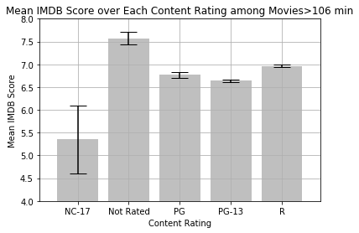
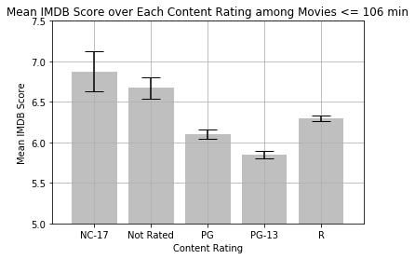
Mean IMDB Score over Each Content Rating among Different Movie Length
ANOVA:
F-Statistic=18.23
P-value=1.07e-14
ANOVA:
F-Statistic:18.94
P-value=2.75e-15
Notes:
Conclusions:
The mean IMDB scores are not identical among all content ratings for both short and long movies.

Slide 18
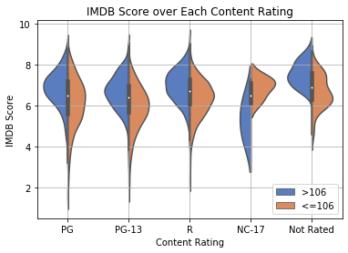
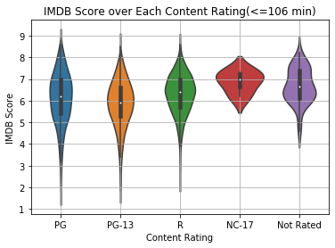
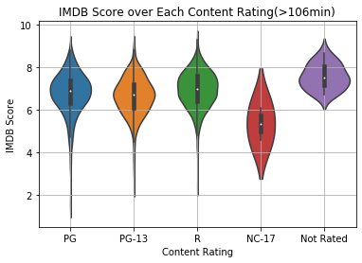
Violin Plot

Slide 19
Conclusions
Duration and content rating both appear to have an effect on profit. Longer movies with g or pg ratings are the most successful
Higher budgets result in slightly higher imdb scores and much higher facebook likes, however, particularly high budgets (over 200 million) result in a loss of profit on average.
The mean IMDB scores are not identical for each content rating.
The mean IMDB score of longer movies(6.82) is significantly higher than shorter movies(6.12).
The mean IMDB scores are not identical for each content rating among longer movies, and it showed the similar pattern among shorter movies.

Slide 20
Conclusions
There is a positive relationship between the number of movies a director has made and how successful those movies are. This may suggest that as directors create more movies over time there is a higher chance of achieving above average success.
There is a weak negative to zero relationship between top actors featured in movies and the average success of their movies. This may suggest that the choice in actor does not have as strong an influence as initially thought. Additionally, top actors will have a higher quantity of movie successes and movie failures as their quantity of movies filmed increases. Hence, explaining why their mean IMDB score average very similar to each other.

Slide 21
Reference
Reference:
1) Trendline for Mean IMDB Score over Years was taken from the stackoverflow answer below:
https://stackoverflow.com/questions/26447191/how-to-add-trendline-in-python-matplotlib-dot-scatter-graphs
2) Number of Movie by Year was taken from below link:
https://www.kaggle.com/aninda123/imdb-movie-analysis

